Slide 1
WIE - LUMINA’25 Hackathon
Problem Statement Title- Centralized Alumni-Student Engagement Platform
Theme- Hack the Campus — Innovate for Everyday Life
Team Name- GIT LOST

Slide 2
IDEA TITLE
Idea
Centralized Alumni-Student Engagement Platform!
The platform is a dynamic, interactive ecosystem designed to bridge the gap between students and alumni. It features a bi-directional posting system where both students and alumni can share content, opportunities, and requests for help.
Proposed Solution
Addressing what everyone looks over!
Addresses Gaps: It fills the gap left by static, fundraising-focused alumni portals by offering real-time interaction and a student-first approach.
Structured Ecosystem: Creates a single, structured hub for students to access mentorship, projects, and job opportunities directly from their college alumni.
Innovation and Uniqueness
Revolutionizing the way students and alumni interact!
Bi-directional Communication: Both students and alumni can initiate engagement by posting content.
AI/ML-Powered Matching: Utilizes smart recommendation engines to provide personalized, relevant suggestions for mentorship, internships, and posts.
Adaptable & Open-Source: Built on an open-source tech stack, making it easily adaptable and scalable for any institution.
Community Hubs: Creates a private space for students and alumni with shared interests, fostering collaboration and strengthening peer networks.
Data regulation: Checks the posts in real time to prevent any bad elements from mixing in with the general flow of posts on the platform.

Slide 3
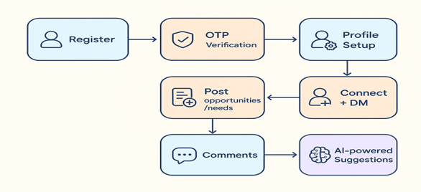
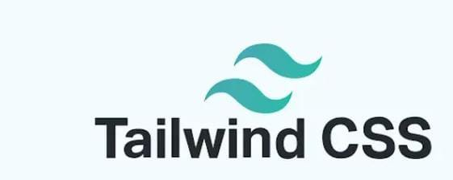


TECHNICAL APPROACH
Technologies to be Used
Supervised ML: Uses Random Forest with Feature Engineering to provide highly accurate mentorship and job recommendations.
Authentication: Email OTP, with role-based access for students and alumni
Spam Detection: AI filters irrelevant or harmful content in posts/comments.
Admin Role: Providing a dedicated admin account for the university to post official announcements, manage events, and supervise posts to ensure content is relevant and appropriate.

Slide 4
FEASIBILITY AND VIABILITY
IMPACT AND BENEFITS
Analysis of the feasibility of the idea
The platform can be built using HTML5 and Tailwind CSS, modern and widely adopted front-end technologies that enable a responsive, efficient, and visually appealing user interface while reducing development time and complexity.
The core features (profiles & posts) are well-established and achievable with the selected technologies.
The chosen AI/ML algorithms, such as Random Forest are standard and efficient for the proposed tasks and can be integrated iteratively without affecting the core functionality.
Potential Impact on the Target Audience
Benefits both Alumni & Students: Provides a mutually beneficial platform for connection and support.
Students: Gain smarter, more direct access to mentorship, guidance, and internship opportunities.
Alumni: Have a simplified way to give back and find students who can benefit from their expertise.

Slide 5
RESEARCH AND REFERENCES
Competitor Analysis
Alumni Portals (JIIT, BITS, IITs): They are mostly static directories for fundraising, with no dedicated features for real-time student-alumni interaction.
Our Edge
Bi-directional Posts: Both students and alumni can actively post.
Granular Privacy: We give users control over which contact details they share.
Personalization: Smart recommendations, ensuring every user sees relevant opportunities and connections.
https://www.iitbombay.org/
https://www.jiit.ac.in/alumnus
https://www.bits-pilani.ac.in/alumni/

